Slide 1

Leveraging Data Science: Predicting Bomb Hours In Israel
By: Adir Amar, Nitay Oppenheimer

Slide 2

Introduction
As in our country, there are several periods time of bombing in each decade, we will try to understand if are some of bombing hours are predictable.
The question is Can data science techniques be utilized to identify predictable patterns of bombing hours in specific areas of our country, thereby enabling the provision of timely advice on proper hours to remain in protected spaces?

Slide 3



Exploring Different Variables to predict Bombs Hours
First, To predict bomb hours in Israel, we need to understand the data.
Includes exploring different variables that can impact bomb threats, such as location, time, and past occurrences.
By analyzing these variables, we can develop predictive models and implement data-driven solutions to prevent attacks.
It is important to remember, this is only by raw data. There are unpredictable reasons such as: political tension, religion causes and so.

Slide 4
Historical Data - Bombs Hours – Data collection
One of the biggest problem we faced, is trying to acquire a reliable source to retrieve the data from and perform our project.
We decide to trust ‘Pikud Haoref’ Api method as this is a real alerting institute driven by the government.
In the acquiring process, we had to make some data cleaning and changes as some of the data was irrelevant or required modification.
We hade to remove un-related data columns such as: matrix_id, rid, category.
In addition, we performed data changes to filter out hour month year from alert data and time columns.

Slide 5

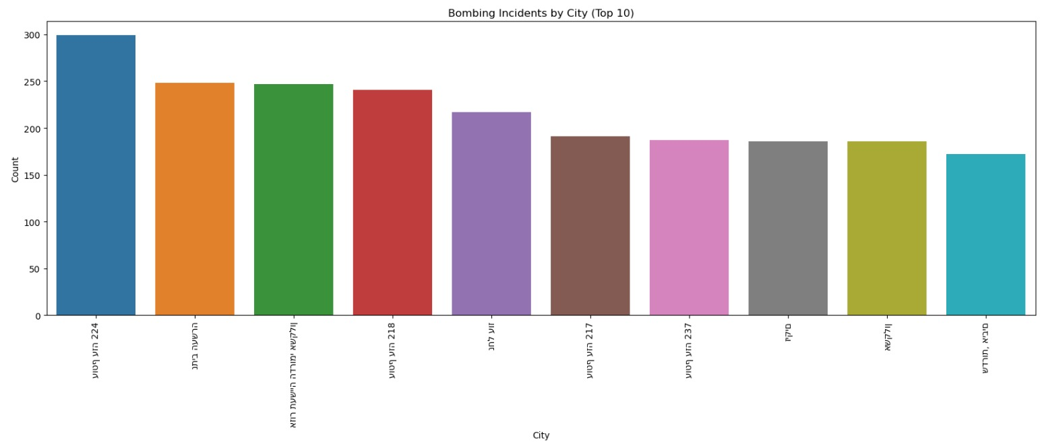
Visualization & EDA
Investigating some statistics helped us understand what are the estimated results should look a like.
We visualized Bombing by hour, by city, by day and by month.

Slide 6
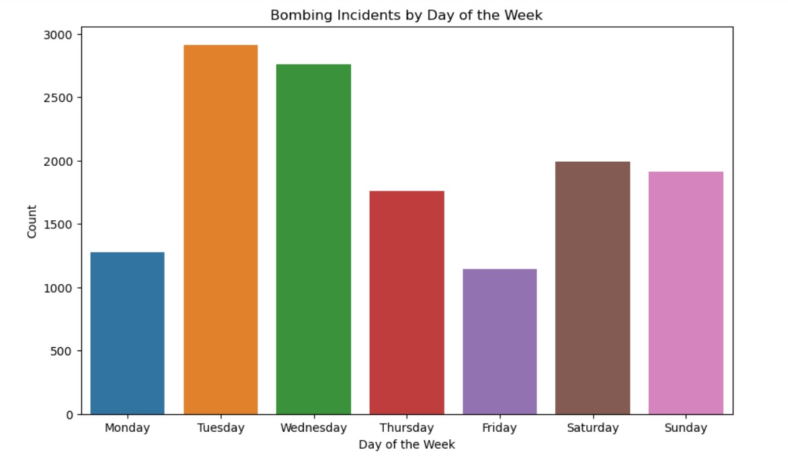
Visualization & EDA

Slide 7
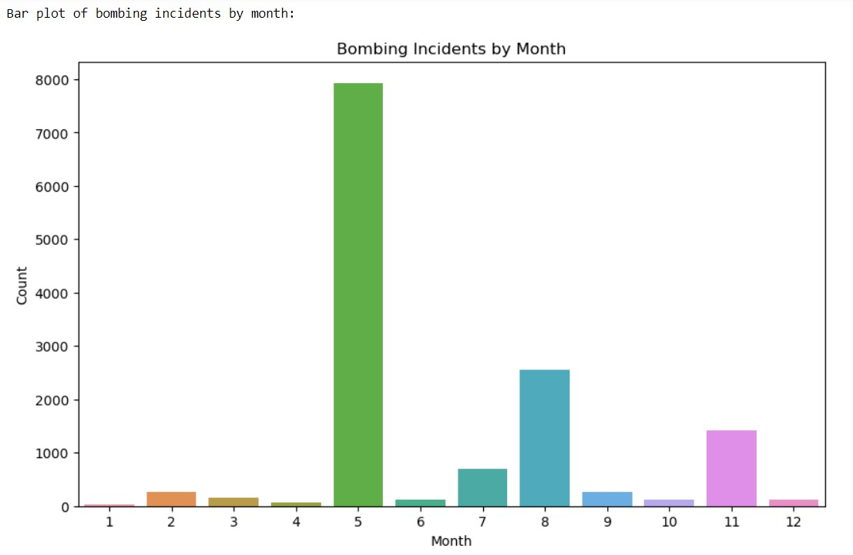
Visualization & EDA

Slide 8
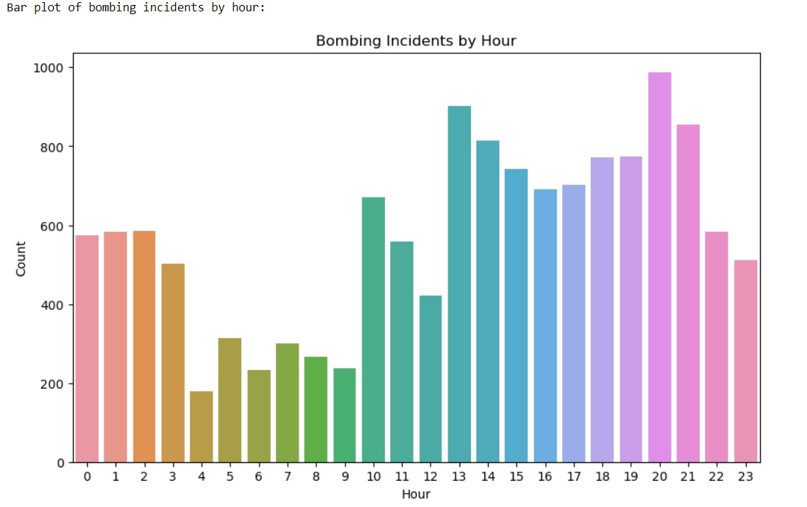
Visualization & EDA

Slide 9

Advanced Data Analysis
As for the big part in our project, the ADA and ML part, we have tried several algorithms for our goal, but most of them were with low accuracy which isn’t our goal. As result, we had chosen one main Algorithm – Kmeans.

Slide 10
Kmeans in our Project
The unsupervised ML algorithm fit to our project thanks to the ability to cluster data points into distinct groups allowing to identify pattern and similarities among the bombing hours. Moreover, kmeans is computationally efficient and can handle large dataset, making it ideal choice for analyzing years of bombing data.

Slide 11
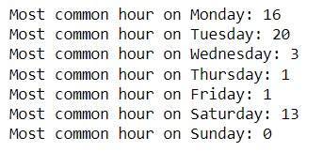

Kmeans - Results

Slide 12
Kmeans - Results
In addition to below results, we were also saved results for each city by our kmeans algorithm a new CSV – city_top_hours.
This CSV display a picture of the algorithm results to each city separately with matched hour.

Slide 13


Conclusions
Picking ML algorithm was the main challenge in our project.
Most of the prediction Algo’ wasn’t accurate enough to ensure predict hour is true.
Eventually, we chose k-means to be our prime algorithm.
K-means Algo’ gave us better picture to rely on while suggesting Hour to be around secure-space.
Please remember, the full result of the algorithm are in attached CSV.

Slide 14
Thank You

